Slide 1
BRACCIO robot project (Early February update)
By Ethan Coke
06/02/2024

Slide 2
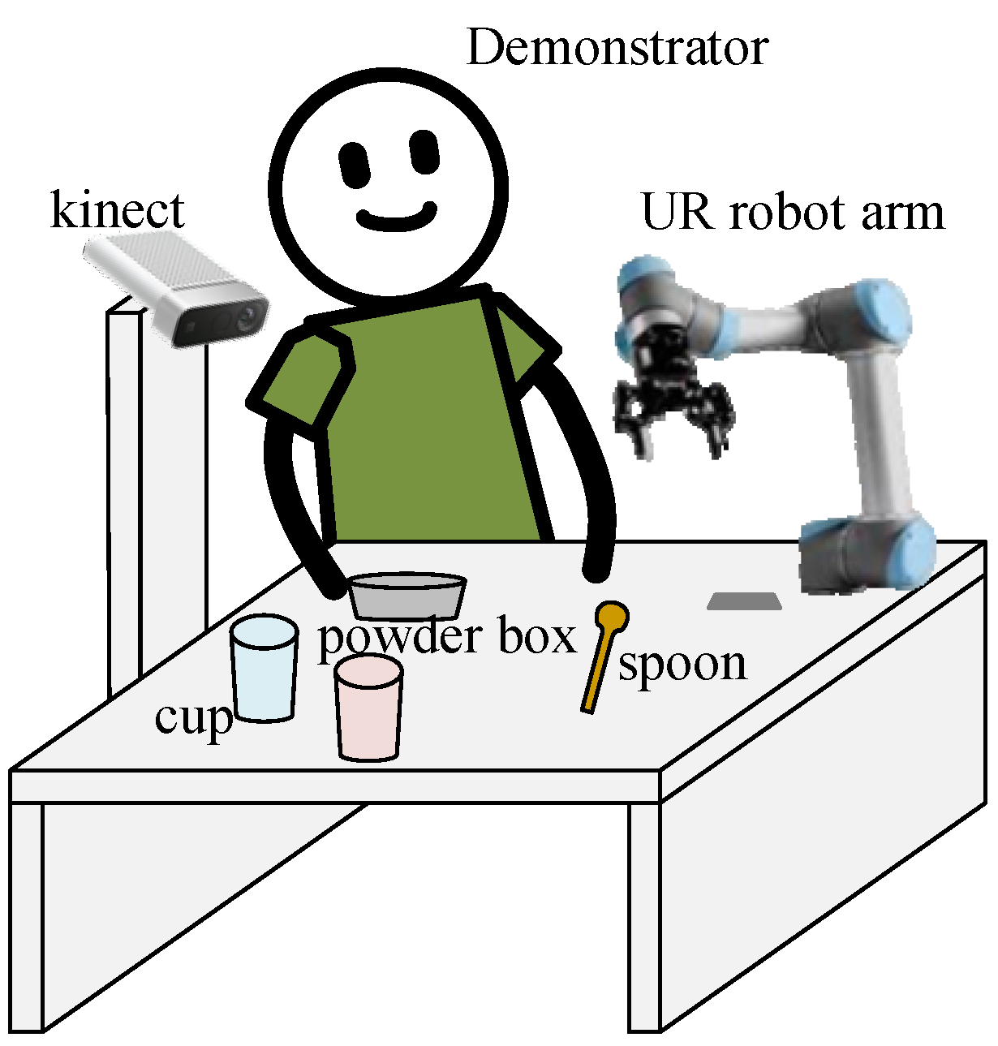
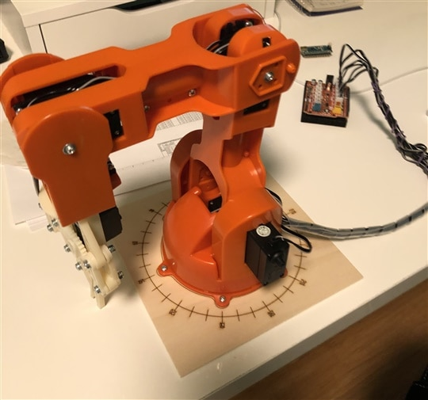
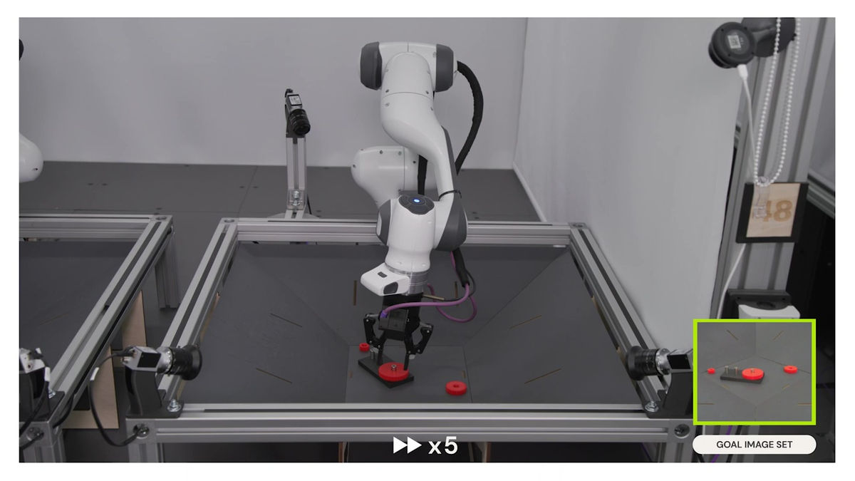
Project Goals and Initial Conditions
I aim to highlight my robotics capabilities through a pick-and-place robot project, using computer vision and the ROS framework.
Using my Braccio robot, I'll simulate integrating a camera by preparing the necessary code

Slide 3
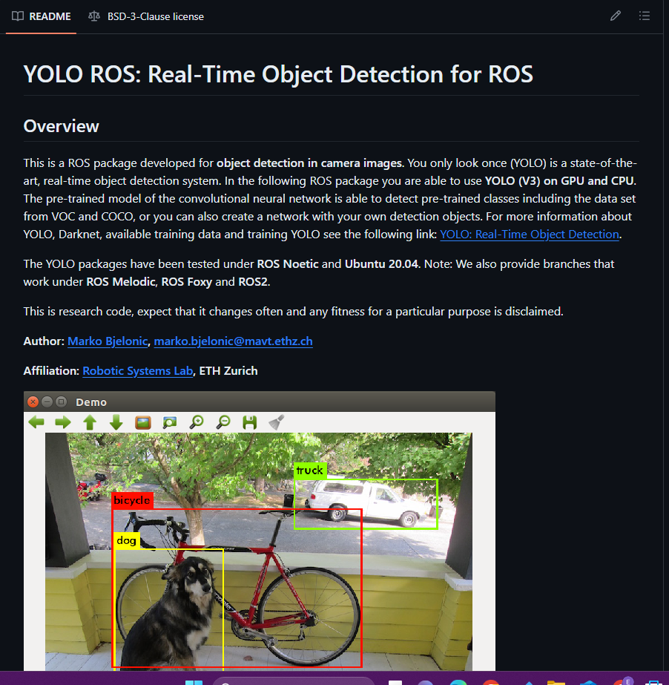
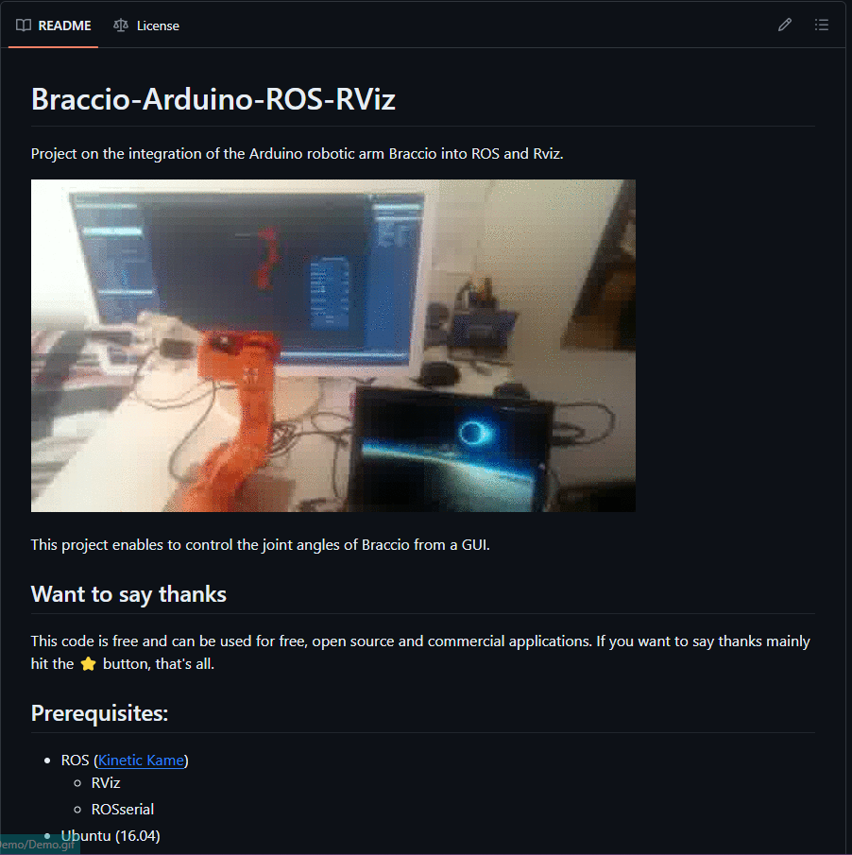
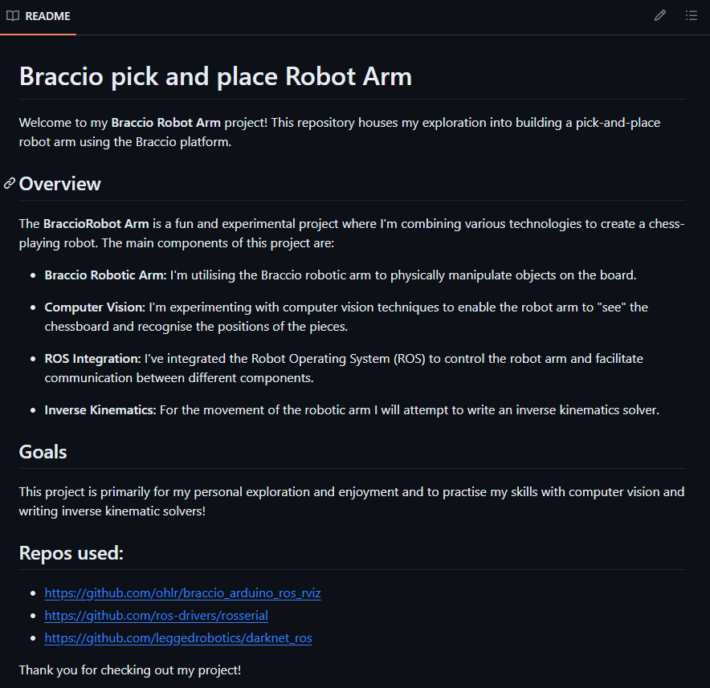
ROS packages + Implementation
Adds the computer vision script that listen to camera topics.
(YOLOv7) with the COCO dataset
Includes a URDF of the Braccio models as well Arduino script to interface ROS
Holds the inverse kinematics publisher and other scripts required for pick-and-place

Slide 4
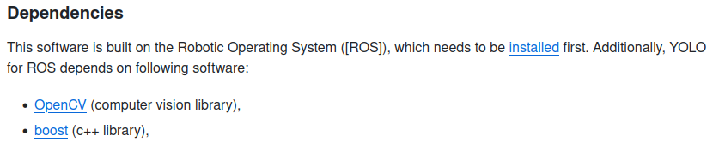
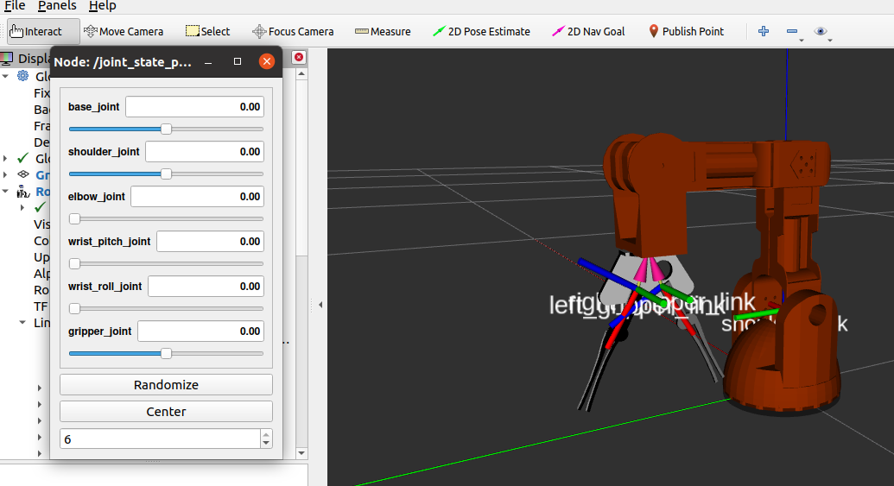
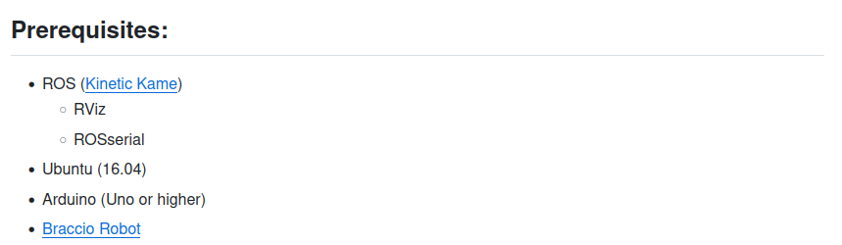
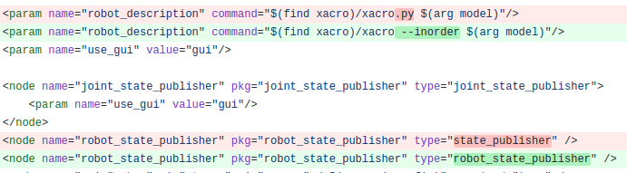
Working through ROS packages

Slide 5
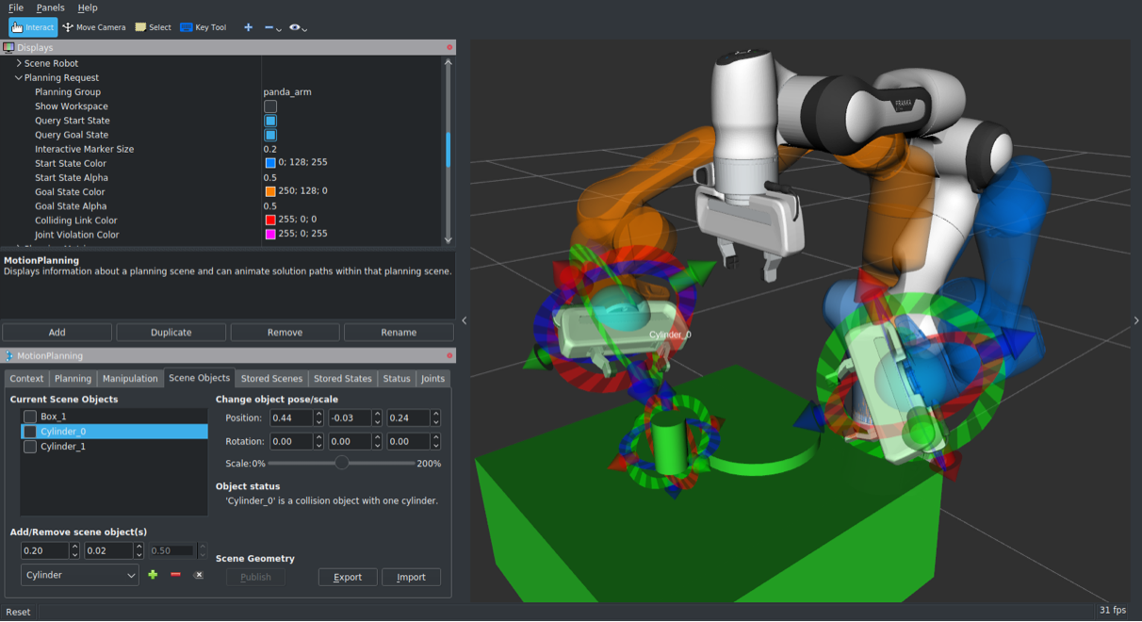

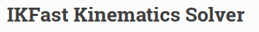
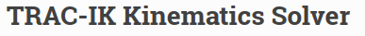

Choosing the right Inverse kinematics for Braccio

Slide 6
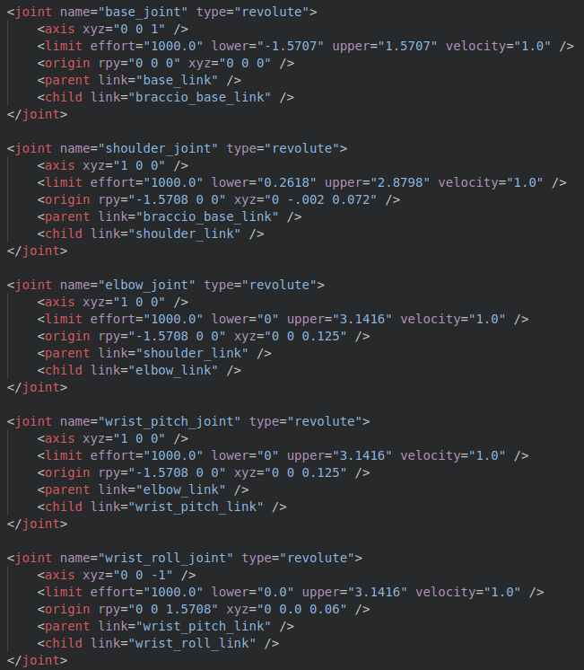
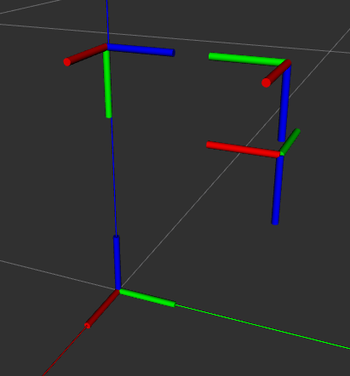
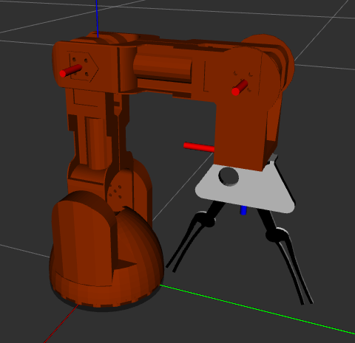










Why I created my own IK model

Slide 7
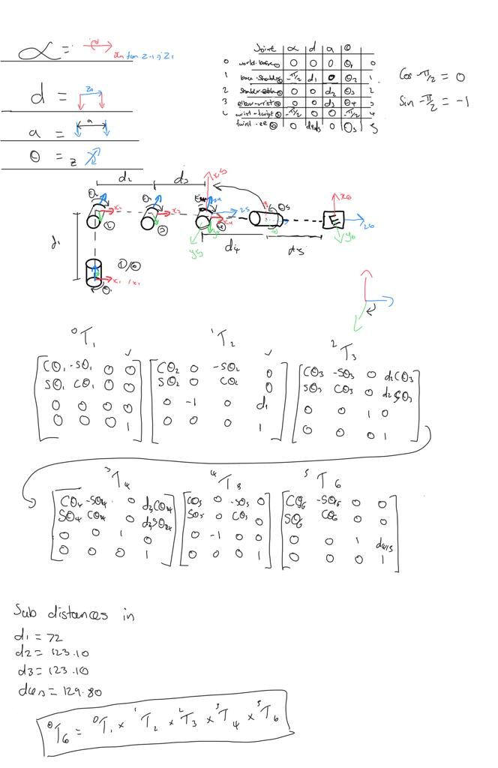
Creating DH parameters and the transformation functions
DH Parameter rules
The z-axis serves as the rotation axis for a revolute joint.
The x-axis, perpendicular to the current and previous z-axes, is determined.
The y-axis is established through the right-hand coordinate system using the x and z-axes.
The x-axis intersects the preceding z-axis, exempting frame 0.

Slide 8
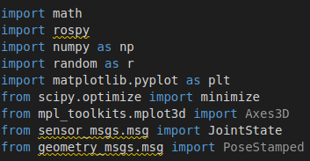
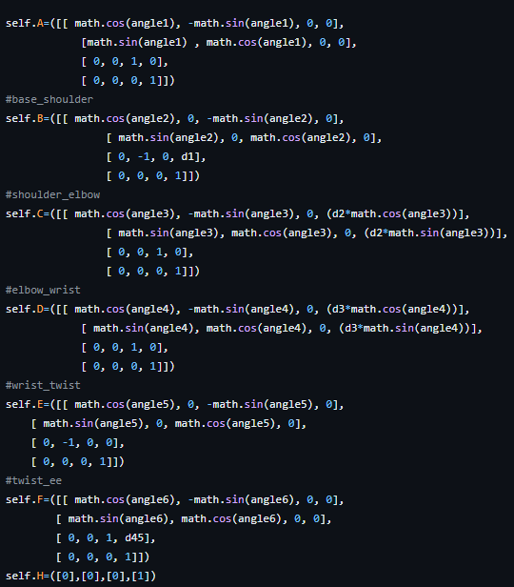
Scripting the Inverse kinematics
Developed a class-based minimisation function for inputting joint angles and goal position, incorporating the 'Nelder-Mead' solver for optimisation.
Features include:
Preventing movement on significant error.
Retrying Inverse Kinematics with varied starting positions.
Notifying users of an impossible position if no solution is found.

Slide 9
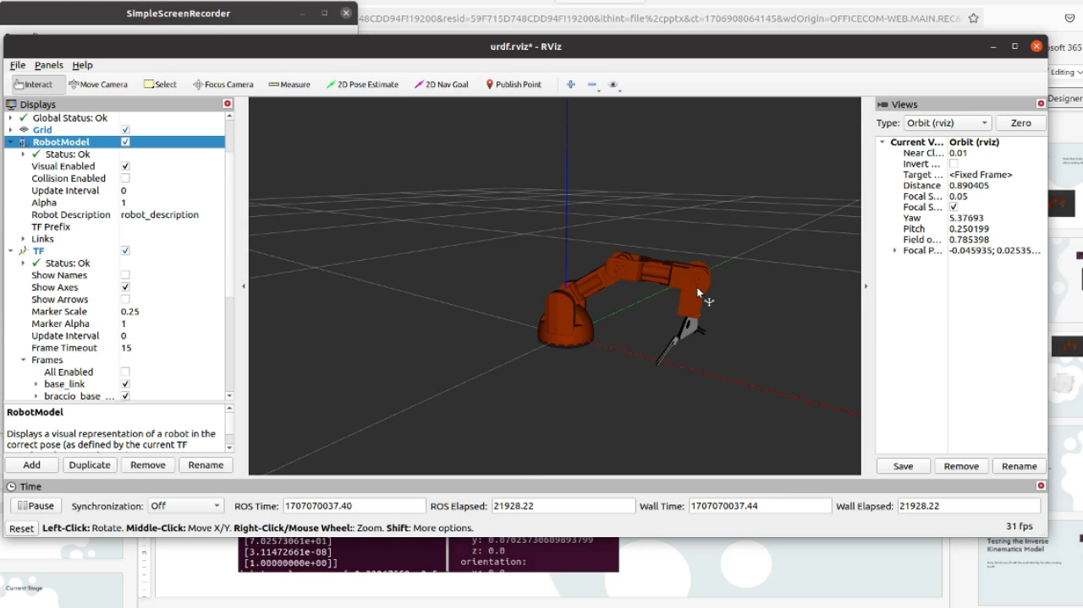
Kinematics demo video

Slide 10
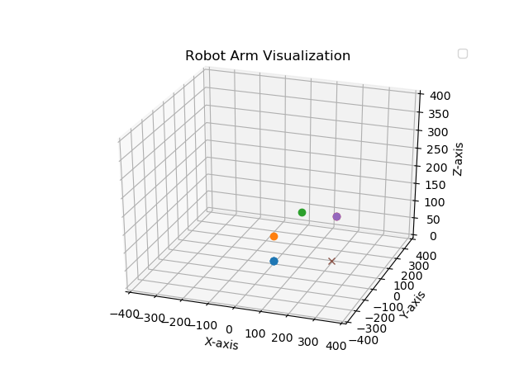
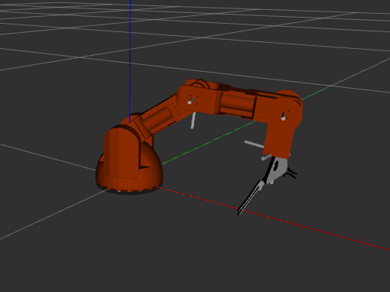
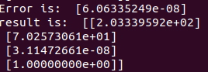
Testing the Inverse Kinematics Model
During testing on real robots, it's important to mention that the end effector position was quite off, likely due to potential breakage, misalignment, and the servos being underpowered.
Commanded position:
[200.] mm
[70.0] mm
[0.00] mm
Error: 6.06 e-08
[203.3] mm
[70.25] mm
[1.000] mm

Slide 11
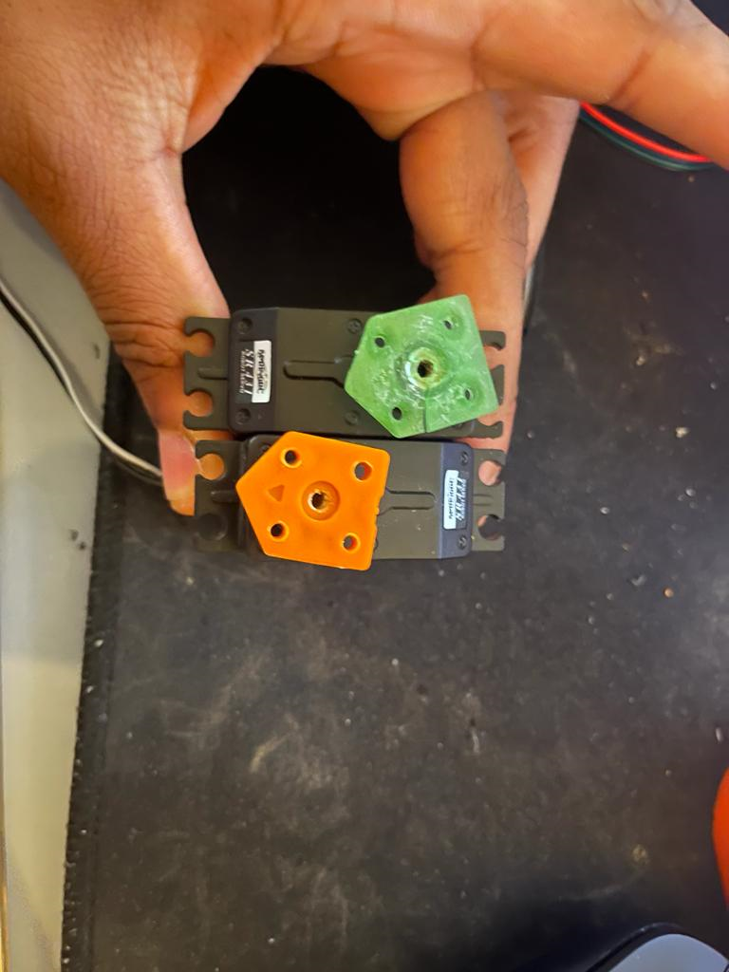


Improving The Braccios Hardware
Challenges with the Braccio robot:
Excessive backlash in the servos.
Suboptimal torque performance.
Persistent issues with breakage in the motor mount plastic.
Lack of specificity in the angle command, leading to inaccuracies in the Inverse Kinematics (IK) system.

Slide 12
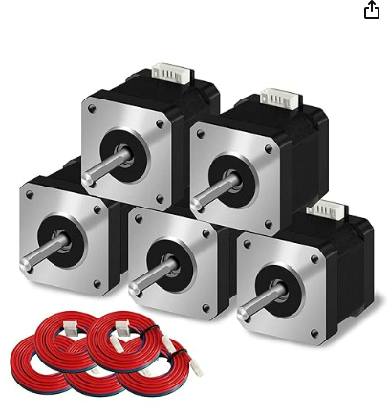
New Motors For The Robot
Item Weight | ‎230 g
Size | ‎42-38
Voltage | ‎3.8 Volts
Horsepower | ‎4.62 Watts
Speed | ‎1.5 Amps
Included components | ‎Nema 17 stepper motor
Torque | ‎42Ncm

Slide 13
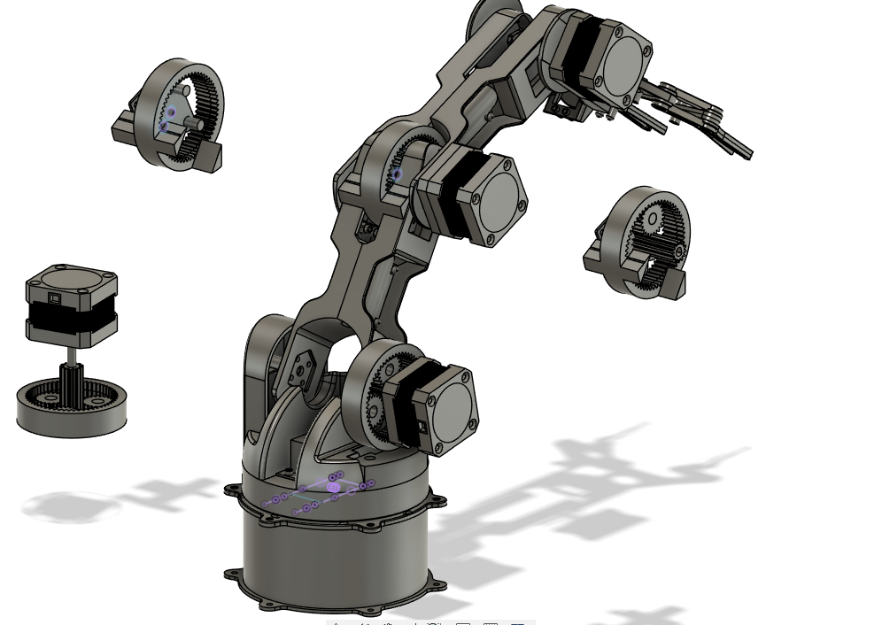
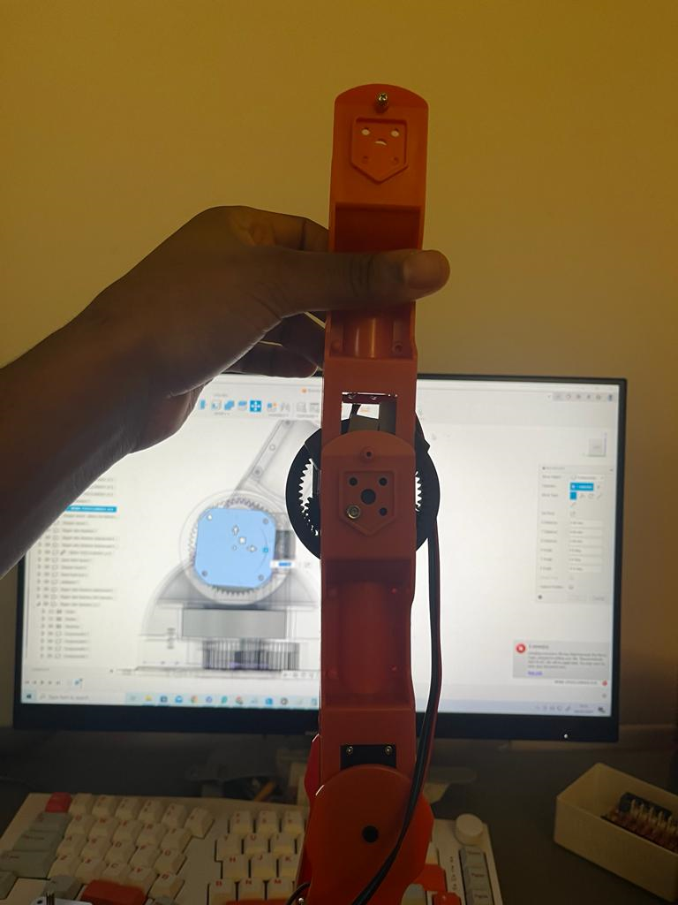
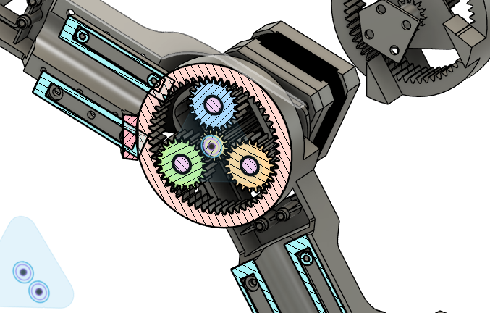
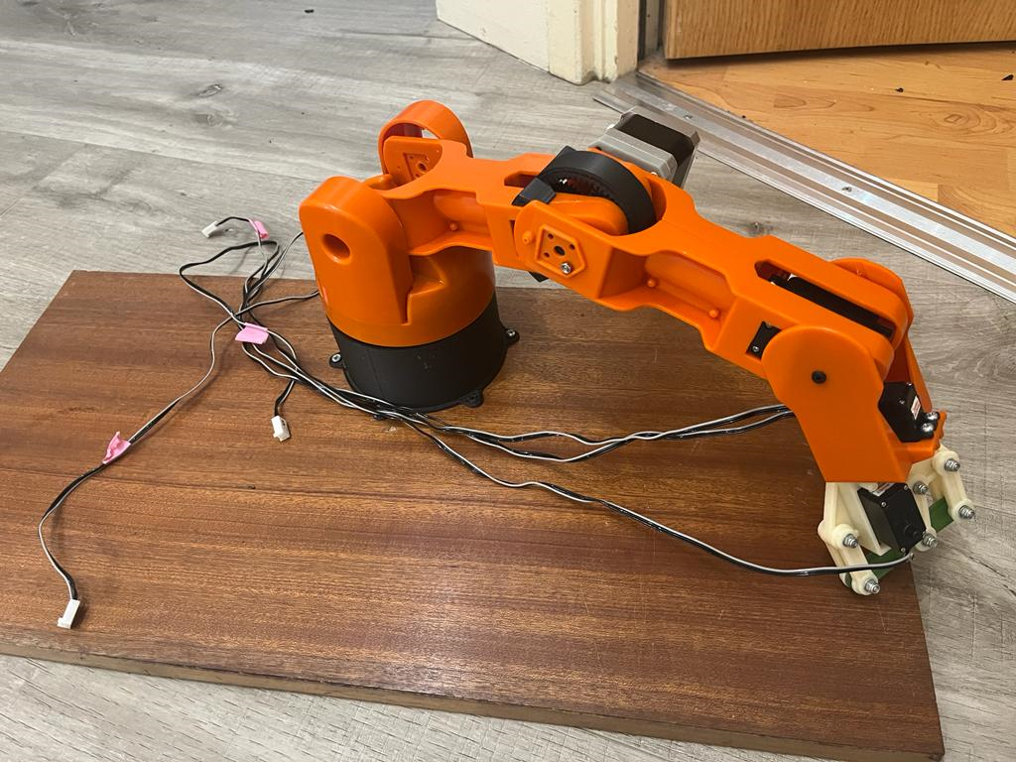
Current Stage

Slide 14
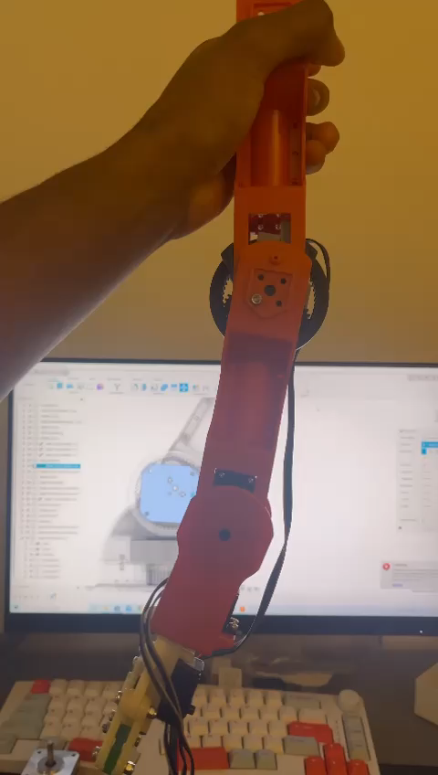

Slide 15
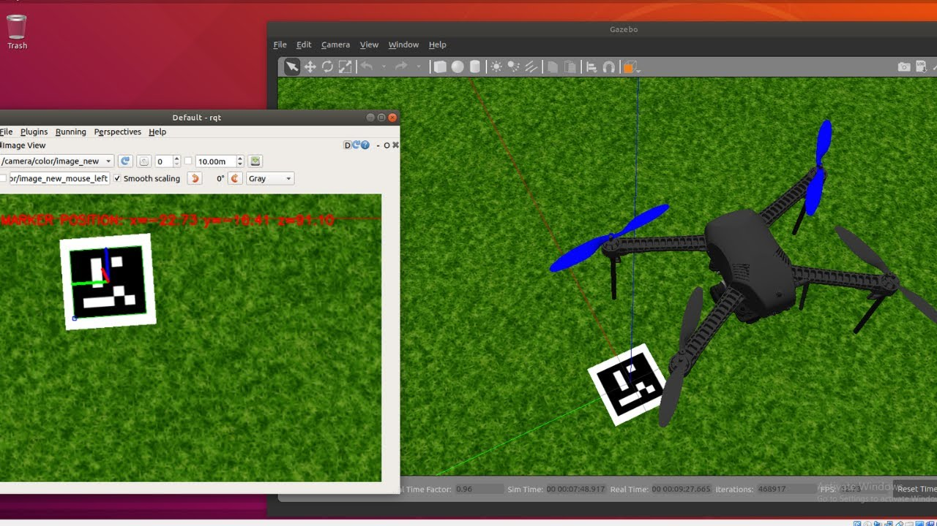
Future Steps
Finalise CAD design for the shoulder joint.
Improve printing tolerances to prevent gear skipping.
Integrate a camera for ROS object detection.
Increase speed of Inverse Kinematics solvers.
Implement path planning and collision avoidance.
Develop automated pick-and-place algorithms with camera data.

Slide 16
What would I do differently?
I should've focused more on simulation development, utilising ROS plugins and Gazebo for pick-and-place algorithms, yielding a more impressive demonstration.
I learned the importance of caution in Git source control, especially when committing folders with modules from other clones, to avoid confusion in the version history.
Recognising the need for adherence to rules, I learned during Inverse Kinematics solver creation that skipping DH-parameter constraints led to prolonged joint axis and parameter assignment.

Slide 17
Thank you
06/02/2024

